Slide 1
CLASSROOM DISCUSSION
Mukhayyarotin Niswati Rodliyatul Jauhariyah, S.Pd., M.Pd.

Slide 2
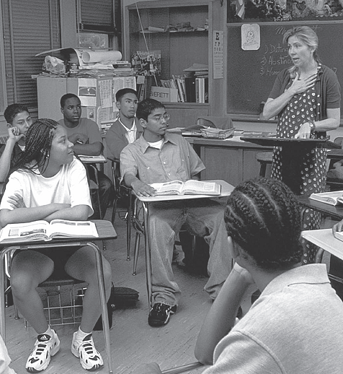
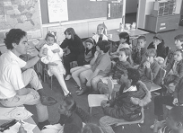

Slide 3
DISKUSI?
Melibatkan siswa dalam kemampuan berbicara dan mengungkapkan tugas pada materi pelajaran tertentu.
Kegiatan menyampaikan ide atau pendapat terhadap suatu permasalahan atau topik tertentu melalui interaksi sosial.
Prosedur yang digunakan oleh guru untuk memperkuat kemampuan komunikasi siswa dengan cara menyampaikan ide atau pendapat.

Slide 4
DISCUSSION vs RECITATION???

Slide 5
LEARNER OUTCOMES FOR DISCUSSION
CONCEPTUAL UNDERSTANDING. Discussion improves students’ thinking and helps them construct their own understanding of academic content.
INVOLVEMENT AND ENGAGEMENT. It gives students public opportunities to talk about and play with their own ideas and provides motivation to engage in discourse beyond the classroom.
COMMUNICATION SKILLS AND THINKING PROCESS. Discussion is used by teachers to help students learn important communication skills and to develop more effective thinking processes.

Slide 6
COMMUNICATION SKILLS
Discussions thus provide social settings in which teachers can help students analyze their thinking processes and learn important communication skills such as stating ideas clearly, listening to others, responding to others in appropriate ways, and asking good questions

Slide 7
FIVE-PHASE SYNTAX OF CLASSROOM DISCUSSION
Explaining the aims of the lesson,
Focusing the discussion,
Holding the discussion,
Bringing the discussion to a conclusion, and
debriefing the discussion.

Slide 8
LEARNING ENVIRONMENT
The environment for conducting discussions is characterized by open processes and active student roles

Slide 9
THEORETICAL AND EMPIRICAL SUPPORT
DISCOURSE AND COGNITION
CLASROOM DISCOURSE PATTERN
TEACHER QUESTIONING
WAIT-TIME

Slide 10
Discourse and Cognition
Discourse is one way for students to practice their thinking processes and to enhance their thinking skills.
A strong relationship exists between language and thinking, and both lead to the ability to analyze, to reason deductively and inductively, and to make sound inferences based on knowledge.

Slide 11
Clasroom Discourse Pattern
We are all familiar with the basic pattern, labeled the initiation-response-evaluation (IRE) model by Cazden (1986, 1988) and Burbules and Bruce (2001). This exchange takes place in a whole-class setting and consists of three phases: • Initiation: Teacher asks a question about the lesson. • Response: Students raise their hands and reply. • Evaluation: Teacher evaluates the response with praise or corrects the response. Teachers often answer the question themselves with a short lecture

Slide 12
Teacher Questioning
During the past decade, researchers have continued to study the controversy over the effects of question types on student achievement and thinking. A consensus appears to be emerging that the type of questions teachers ask should depend on the students with whom they are working and the type of educational objectives they are trying to achieve (Gall, 1984; Marzano, 2007; Walberg, 1999).

Slide 13
Teacher Questioning
Emphasis on fact questions is more effective for promoting young children’s achievement, which involves primarily mastery of basic understandings and skills.
Emphasis on higher cognitive questions is more effective for students when more independent thinking is required.
A large proportion (perhaps as high as three-fourths) of a teacher’s questions should be at a level that will elicit correct answers from students in the class.
The other one-fourth of the questions should be at a level of difficulty that will elicit some response from students, even if the response is incomplete.
No question should be so difficult that students will not be able to respond at all.

Slide 14
WAIT-TIME
Wait-time is the pause between a teacher’s question and the student’s response and between the response and the teacher’s subsequent reaction or follow-up question

Slide 17
STRATEGIES ON CLASSROOM DISCUSSION
Think-Pair-Share: it has built-in procedures for giving students more time to think and to respond and can affect the pattern of participation.
Buzz Group: a teacher asks students to form into groups of three to six to discuss ideas about a particular topic or lesson. Each group assigns a member to list all the ideas generated by the group. After a few minutes, the teacher asks the recorders to summarize for the whole class the major ideas and opinions expressed in their group.
Beach Ball: The teacher gives the ball to one student to start the discussion with the understanding that only the person with the ball is permitted to talk. Other students raise their hands for the ball when they want a turn.

Slide 18
KELEBIHAN CLASSROOM DISCUSSION
Menguasai bahan/materi diskusi.
Memecahkan persoalan.
Perkembangan moral.
Perkembangan tingkah laku.
Meningkatkan keterampilan komunikasi.
Melatihkan keterampilan berpikir tingkat tinggi.

Slide 19
KELEMAHAN CLASSROOM DISCUSSION
Membutuhkan waktu yang cukup lama untuk persiapan.
Metode ini tidak akan berhasil jika anggota kelompok terdiri dari individu yang tidak tahu apa-apa.

